Slide 1
CSWG Simulations NIRCam Edition
Jarron Leisenring
University of Arizona
July 19, 2021

Slide 2
Comparison to WebbPSF Defaults
OTE OPDs and PSFs

Slide 3
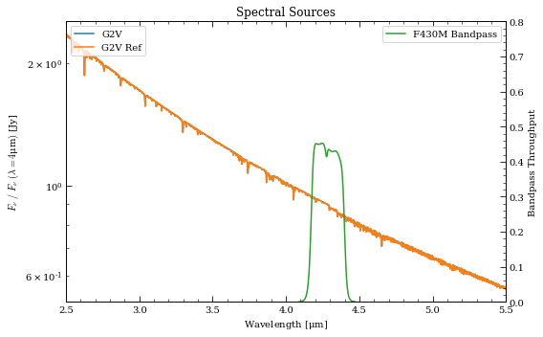
NIRCam Obs Configuration
NIRCam Coronagraphy
MASK430R + F430M
SUB320
MEDIUM8, NG=7, NINT=50
Exp time ~3600 sec
G2V source from BOSZ models
T_{eff} = 5777K
log_{g} = 4.43
[Fe/H] = 0
2MASS K_{s} = 3.27
Corresponds to ~100 million ph/sec through F430M bandpass

Slide 4
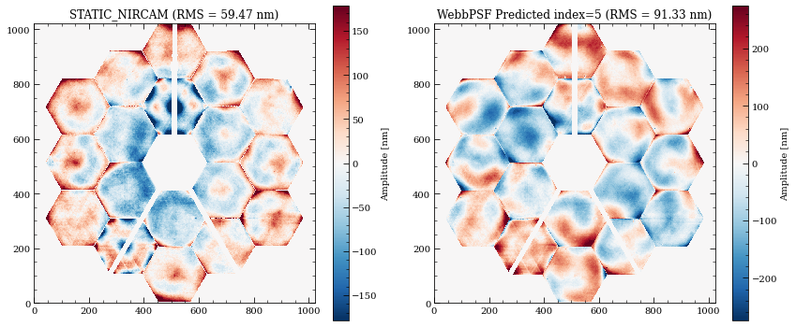
OTE WFE Comparisons
Notes:
WebbPSF comes with two FITS files, requirements.fits and predicted.fits.
Each FITS has 10 independent realizations.
These are based on measured flight mirror surfaces (for high spatial frequencies), plus statistical models for their alignment in flight following wavefront sensing and control (for mid and lower spatial frequencies)

Slide 5
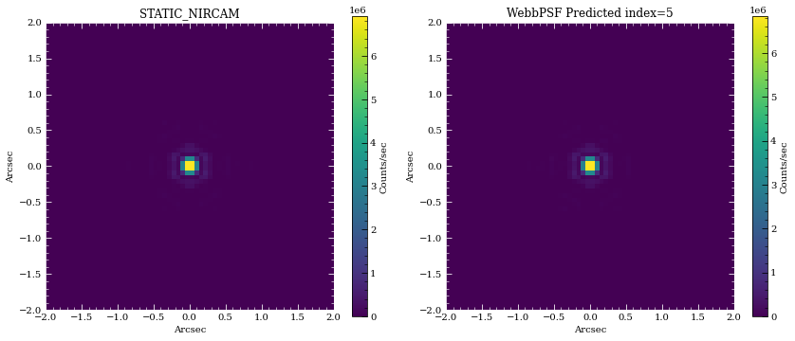
OTE WFE only – Direct Imaging PSF
Notes:
Direct imaging PSF (F430M)
Includes stellar spectrum (total flux ~100M e-/sec)

Slide 6

OTE WFE Comparisons + Lyot Mask
Notes:
NIRCam Lyot stop for circular occulting masks

Slide 7
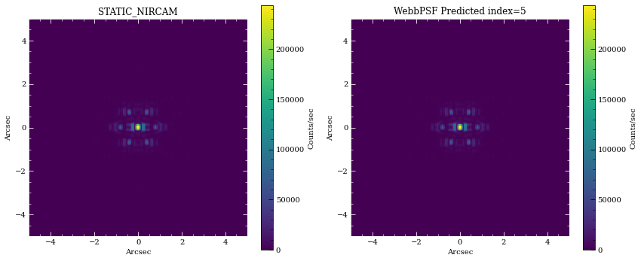
OTE WFE only – Off-axis Coronagraphic PSFs
Notes:
Off-axis PSFs also look very similar

Slide 8
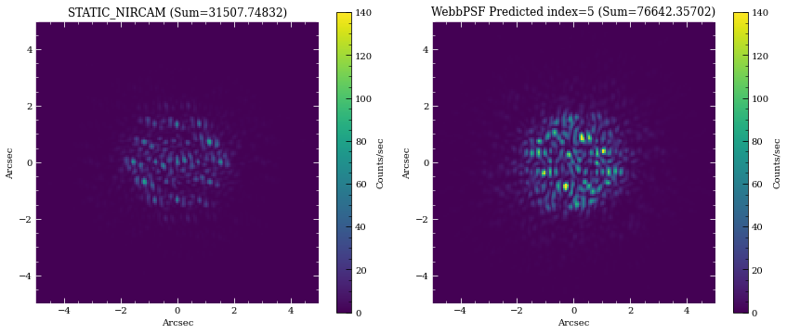
OTE WFE only – Occulted PSFs (MASK430R)
Notes:
On-axis occulted Coronagraphic PSF (F430M + MASK430R)
New OPD shows much higher suppression compared to WebbPSF OPD
Primarily due to factor of ~1.5 lower RMS on the OPD map
Very distinct segment pattern

Slide 9
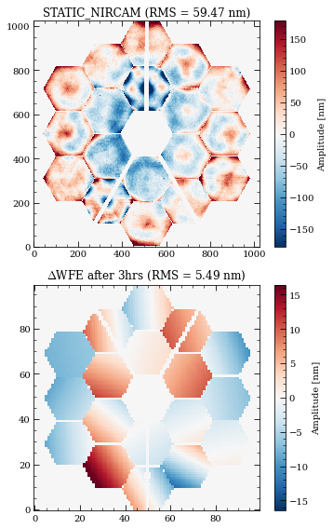
Delta WFE components
The provided Thermal, Frill, and IEC maps are undersampled (100x100) and flipped compared to STATIC_***_INPUT.fits
Create new OPD at given time step
Flip drift components up-down
Rebin to 1024x1024
Add to static OPD
Notes:
Delta OPD
- requirements scenario
- after 3hrs
- added all three components together (frill and IEC dominate)

Slide 10
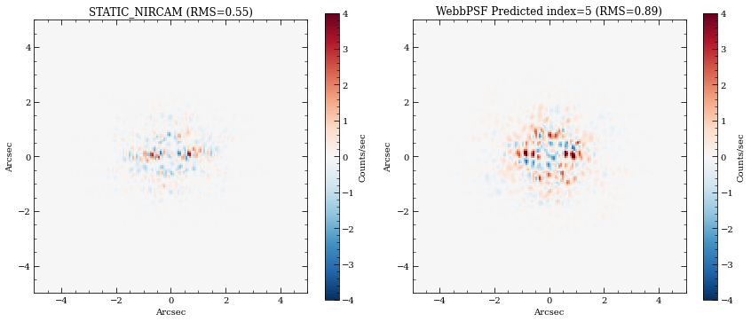
PSF Differences (WFE Drift of 5.5 nm)
Notes:
Improved blocking directly translates to lower speckle noise for the same WFE drift

Slide 11
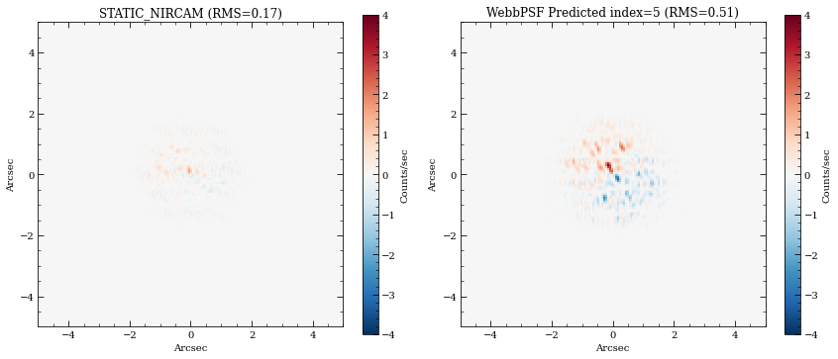
PSF Differences (TA offset of 10 mas)
Notes:
Compare target acquisition offsets with same OPD maps.
Offset PSF is sub-pixel shifted
- Fourier imshift and cubic interpolation produce very similar results
- Linear interpolation does a poor job of sub-pixel shifting

Slide 12
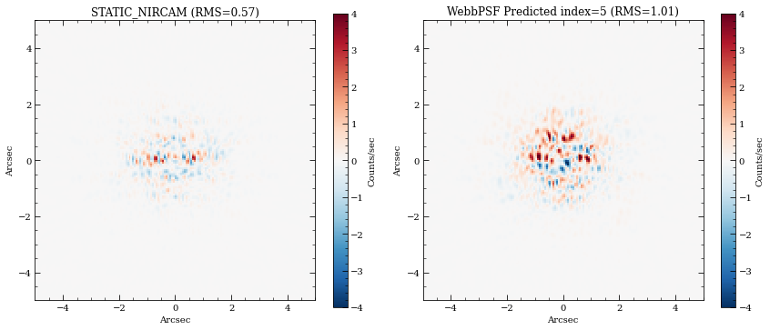
PSF Differences (TA + WFE drift)
Notes:
Target acquisition offset of 10mas plus WFE drift of 5.5nm RMS
- Very similar speckle noise to just WFE drift of 5.5nm
- TA offsets ~10 mas therefore have negligible contributions

Slide 13
Intermediate Conclusions (MASK430R)
Delivered OPD maps produce better coronagraphic suppression compared to WebbPSF’s *_predicted.fits and *_requirements.fits
Should result in improved contrast at <2” by almost a factor of 2 (???)
WFE Drift vs Target Acquisition offsets
TA offsets of 10 mas produce small residual speckle noise compared to WFE Drift of 5.5 nm RMS
TA offsets may dominate for small WFE drifts, though
Likely depends on mask and filter
Effects from jitter considered later…

Slide 14
LOS Jitter
LOS Jitter values correspond to time steps every 37.7 sec
Jitter should be higher frequency (>1 Hz)
Will blur PSFs over an integration time
Enough samples over an exposure should also work
Adopt random jitter draws for each group (1.4 sec)
Need 2 x 50 x 7 = 700
Delivered LOS_JITTER.fits file does not provide enough independent values
Generated appropriately sized random arrays using [2.5, 3.8, 5.8] mas per axis

Slide 15
Observation Simulations
Using delivered OPD files (e.g., STATIC_***_INPUT.fits)

Slide 16
NIRCam Obs Configuration
NIRCam Coronagraphy
MASK430R + F430M
SUB320
MEDIUM8, NG=7, NINT=50
Exp time ~3600 sec
G2V source from BOSZ models
T_{eff} = 5777K
log_{g} = 4.43
[Fe/H] = 0
2MASS K_{s} = 3.27
Corresponds to ~100 million ph/sec through F430M bandpass

Slide 17
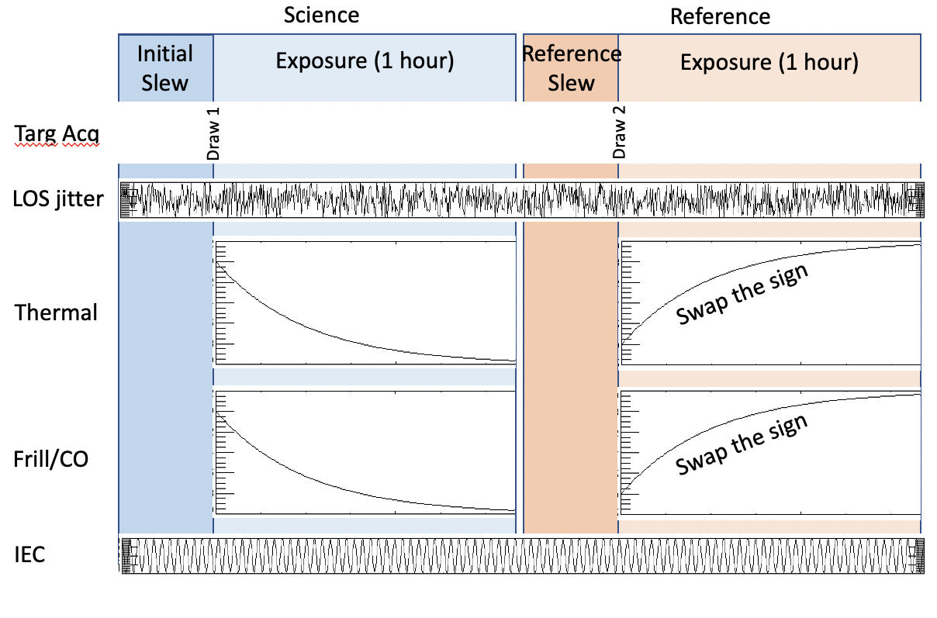
NIRCam Obs Configuration
NIRCam Coronagraphy
MASK430R + F430M
SUB320
MEDIUM8, NG=7, NINT=50
Exp time ~3600 sec
G2V source from BOSZ models
T_{eff} = 5777K
log_{g} = 4.43
[Fe/H] = 0
2MASS K_{s} = 3.27
Corresponds to ~100 million ph/sec through F430M bandpass
Notes:
- Each INT receives an independent OPD map that is the sum of the three components (thermal, frill, IEC).
- Each group within an INT has an independent jitter draw in random direction with same statistical amplitude.
- For reference obs, there is a single target offset in (+X, +Y) for all INT
- Include WebbPSF’s static SI WFE
- The slew scenario here imparts a symmetry in thermal/frill drift that minimizes the average dWFE between sci and ref

Slide 18
Results – Base Case (<dWFE> = 0.7 nm)
Notes:
Left is a raw PSF
Middle is avg sci – avg ref
Right is avg sci – avg ref (aligned)

Slide 19
Results – Nominal (<dWFE> = 1.3 nm)
Notes:
Left is a raw PSF
Middle is avg sci – avg ref
Right is avg sci – avg ref (aligned)

Slide 20
Results – Requirements (<dWFE> = 3.5 nm)
Notes:
Left is a raw PSF
Middle is avg sci – avg ref
Right is avg sci – avg ref (aligned)

Slide 21
Noise Components
Want to disentangle contributions from:
WFE drift noise
Jitter
TA offsets
Calculate RMS of sci-ref differenced images
Generate contrast curves
Right: Case of jitter=0, TA=0.
Notes:
Without jitter and TA, this simulation process shows very low residual speckle noise.
This is likely due on account of the small thermal timescales probed (sci=1hr, ref=1hr).
And the assumption of a symmetric slew/pitch angles.

Slide 22
Average OPD drifts (nm RMS)
Best, Nom, Req = (0.7, 1.3, 3.5)
Jitter & TA dominate residual speckle noise and contrast

Slide 23
WFE Drift + Jitter
TA Offset

Slide 24
Jitter
TA Offset
Notes:
Constant WFE drift, changing jitter, changing TA

Slide 25
Jitter
TA Offset
Notes:
Constant WFE drift, changing jitter, changing TA

Slide 26
Jitter
TA Offset
Notes:
Constant WFE drift, changing jitter, changing TA

Slide 27
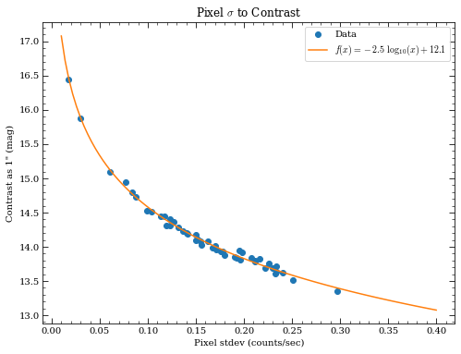
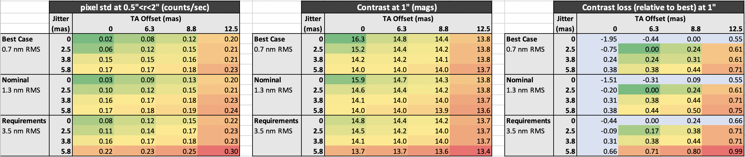
Performance Metrics
WFE drift, jitter, and TA offset each contribute towards residual speckle noise.
Add contributions in quadrature.
Convert noise to contrast.
Notes:
Distill images and contrast curves into performance metrics

Slide 28
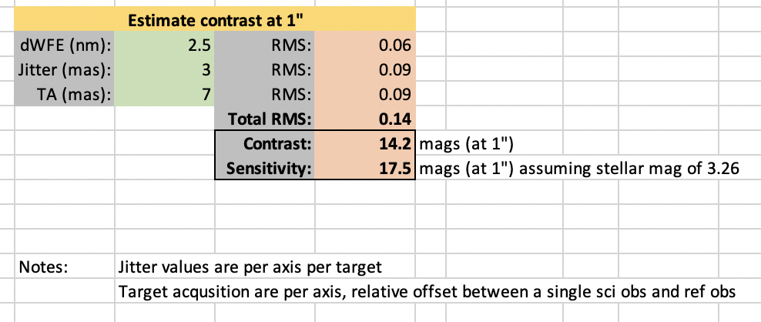
Performance Metrics
WFE drift, jitter, and TA offset each contribute towards residual speckle noise.
Add contributions in quadrature.
Convert noise to contrast.
Notes:
Distill images and contrast curves into performance metrics

Slide 29
Conclusions (MASK430R)
The simulated WFE drifts ( [0.7, 1.3, 3.5] nm RMS) have a minimal impact on the contrast relative to jitter and TA offsets.
Low RMS of static OPD (compared to WebbPSF defaults)
Small timescales probed (sci=1hr, ref=1hr)
Assumed symmetric pitch angles for sci and ref slew (eg., +10 deg then -10 deg), which minimizes average drifts between the two observations.
Jitter
For Nominal TA pointing, the range of jitter values (2.5-5.8 mas) produces a contrast difference of ~0.25 mag at 1”.
Target Acquisition Offsets
For Nominal Jitter, contrast difference across TA: TA[12.5] – TA[6.3] = 0.4 mag

Slide 30
To-Do
Same analysis for different M210R and M335R
Try the WebbPSF OPDs
Distribute TA offsets between science and reference
Implement SGD and PCA analysis
Same output between simulations
Run both NIRCam and MIRI sims through something like pyKLIP
Same visualizations

